Slide 1

Tutorial 2
Matthew Acates, Harshil Patel, & Adam Waleed

Slide 2
Tutorial 2 - overview
Data: Haemophilus (H.) Influenzae 16S (ribosomal RNA)
Data alignment using MAFFT algorithm
Phylogenetic tree made using RAxML and FastTree algorithms
Visualized through iTOL
Tool to display and work with phylogenetic trees

Slide 3
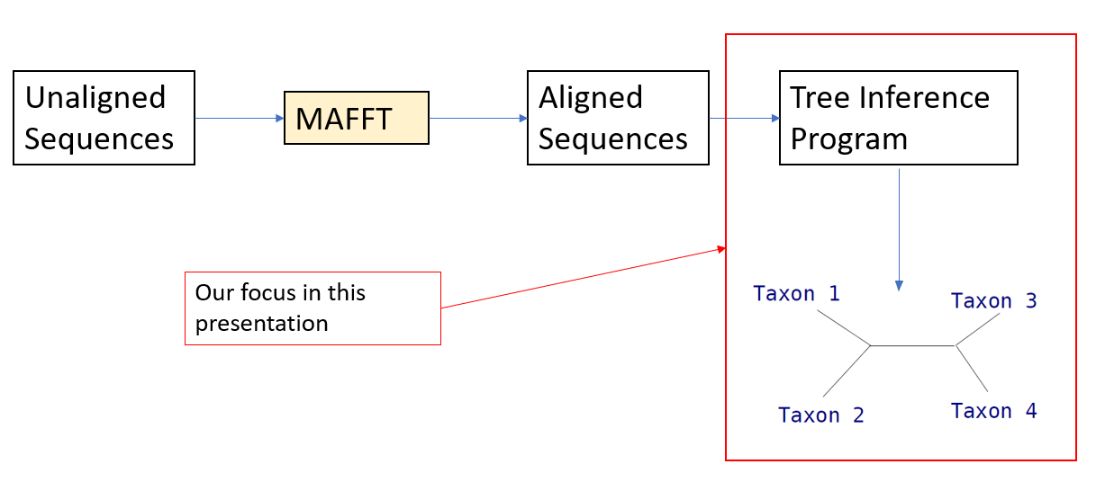
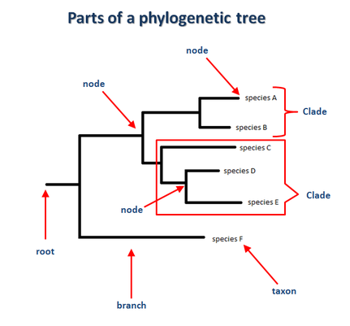
Phylogenetic trees
Shows relationships among biological species based on similarities/differences
Nodes at the end of the branches are the taxons
Could be species, family, class, etc
Common criteria in creating phylogenetic trees:
Maximum Parsimony
Minimizes evolutionary steps
Slow
Unreliable
Maximum Likelihood
Emphasis on similarity between data
Very slow
Reliable
Minimum Evolution
Similar to maximum parsimony

Slide 4
Haemophilus Influenzae 16S
Domain: Bacteria
Input data extracted from Picotte
42 different sequences

Slide 5
MAFFT - Overview
MAFFT stands for Multiple Alignment Using Fast Fourier Transform
Heuristic method: build up MSA from sequence pairs
Why MAFFT?
Useful for hard-to-align sequences
Simplified scoring method
Maintained accuracy
Reduced CPU time
Other common methods:
Clustal
GCG
Muscle

Slide 6
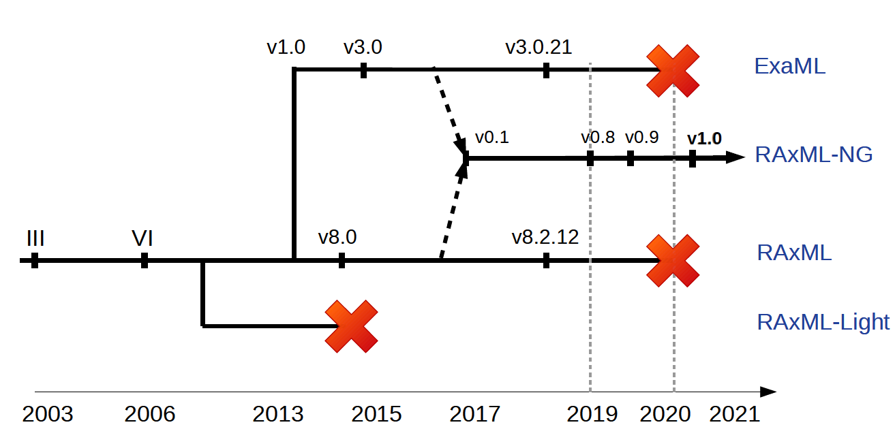
raxML
Randomized Axelerated Maximum Likelihood
Maximum-Likelihood based inference of large phylogenetic trees
Originally derived from fastDNAml
Infact, it has been evolved over a period of time

Slide 7
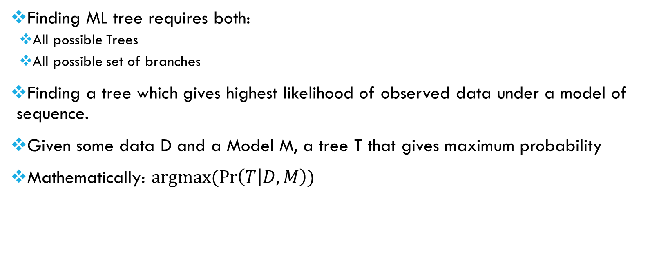
RAxML: Maximum Likelihood
Finding ML tree requires both:
All possible Trees
All possible set of branches
Finding a tree which gives highest likelihood of observed data under a model of sequence.
Given some data D and a Model M, a tree T that gives maximum probability
Mathematically: $argmax(\operatorname{Pr}\left(T | D,M\right))$

Slide 8
RAxML: Maximum Likelihood
Calculates the probability under a given model (including tree structure, branch length, and transition parameters), of the observed data
Probability of each site and each branch is calculated.
It’s a function of tree shape and branch lengths
Likelihood is proportional to this probability
Tree(s) with maximum likelihood is desired.

Slide 9
RAxML: Two-Step Method
Compute Randomized Stepwise addition Order Maximum Parsimony Tree
Parsimony is simpler, discrete criterion to score trees – much faster
Apply Lazy Subtree Rearrangements
Randomization matters:
Using simpler criterion, we can get
We can randomize a tree in such a way that we can generate several topological distinct startup treatments
Lazy subtree Rearrangements
Subtree Pruning and Regrafting
Lazy Subtree Pruning and Regraftin

Slide 10
fasttree
Maximum likelihood phylogenetic trees
Large sequences use distance-matrix methods
FastTree is more accurate than these
Speed is focal point
Stages:
Heuristic Neighbor Joining
Tree Length Reduction/Minimum Evolution
Maximizing Likelihood
Local Support Values

Slide 11


Fasttree – heuristic neighbor joining
Profile distance from pair members to new node:
“u” is the new node, “f” and “g” are the paired taxons
Profile distance of other taxons from new node:
“k” is the “destination point”

Slide 12
Fasttree – tree length reduction
Typically consists of tree rearrangement from previous stage
Nearest Neighbor Interchange (NNI)
Searches for shortest profile distance among neighbors in subtrees to rearrange
Slow
Most optimizing
Subtree Pruning and Regrafting (SPR)
Removes subtree and reinserts it elsewhere
Wide range

Slide 13
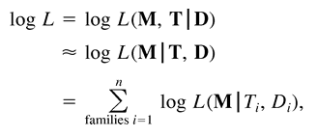
Fasttree – maximizing likelihood
Attempts to optimize branch lengths to avoid loss of information between taxons
Log likelihood is stated as:
D is the aligned data
T is the topology
M is the exchangeability parameter

Slide 14
Fasttree – local support value
Attempts to validate the reliability of the tree
Resampling is done on alternate topologies for optimization
Similar to bootstrapping where estimation based on current build is executed

Slide 15
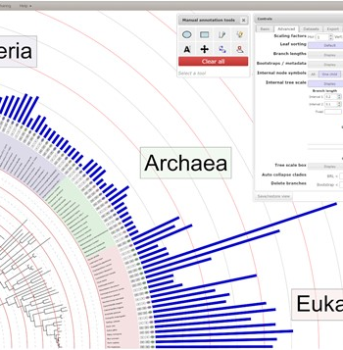
Itol
Is an online visualization tool that is used to generate and manage datasets of phylogenetic trees.
Various tree display designs such as circular, rectangular, and unrooted views are available with annotated options or features for nodes and branches.
ITOL utilizes JavaScript and HTML5 canvas to generate the tree display with the associated functions and calculations done on the client-side web browser.

Slide 16
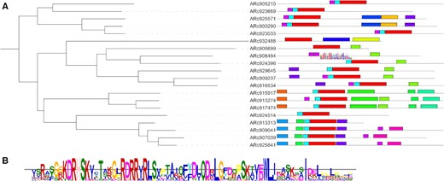
ITOL
Manual annotations and drawing tools are supported by the software.
Different datasets types can be used for visualization including QIIME FeatureData [AlignedSequence] and QZA files.
Input files used to generate phylogenetic trees are made in Newick, Nexus, and phyloXM.

Slide 17
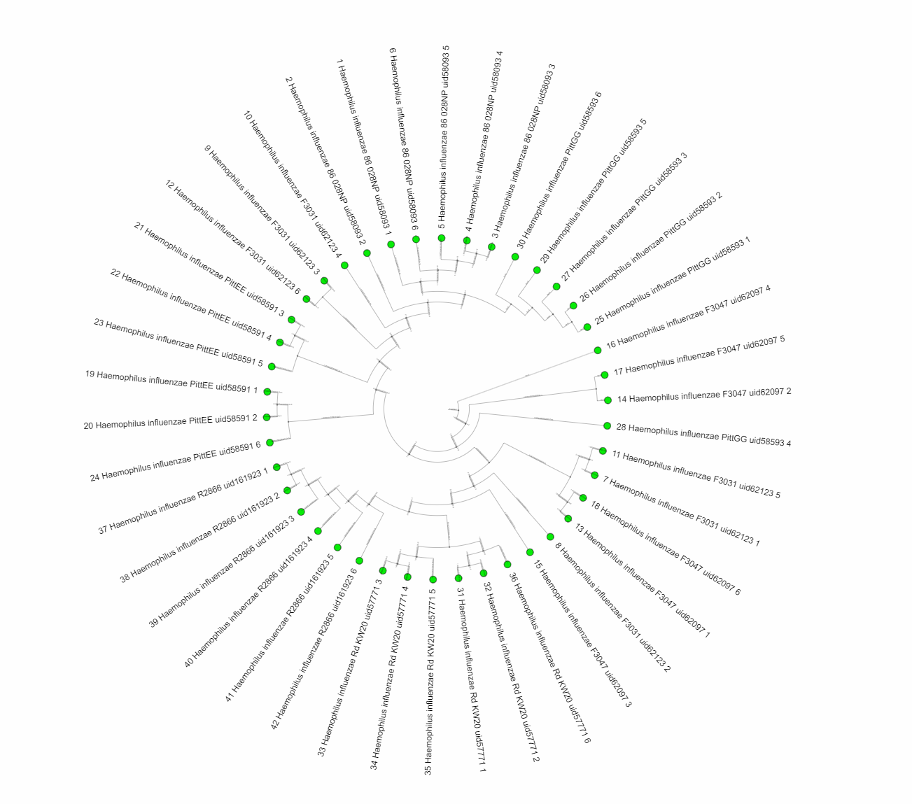
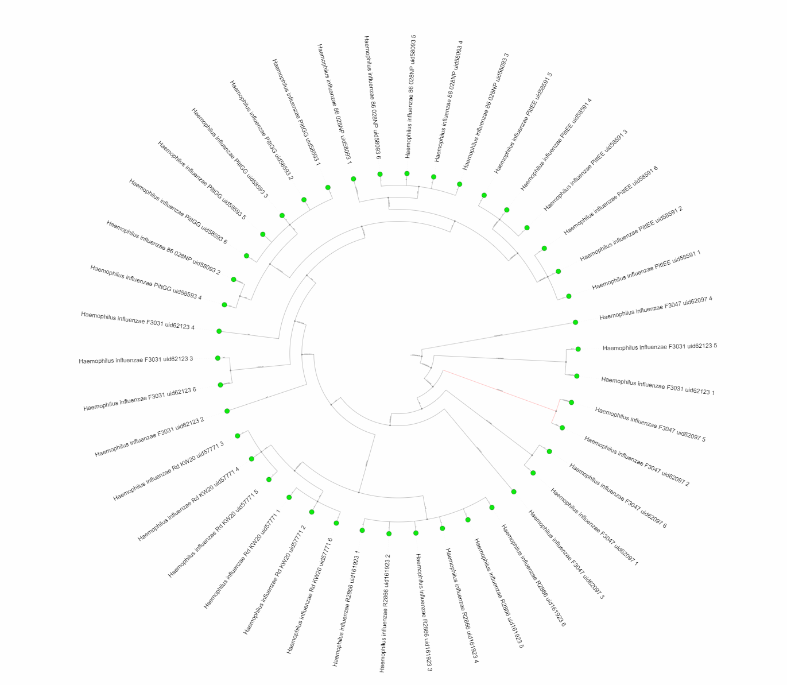
results
FastTree Generated Tree
RaxML Generated Tree

Slide 18
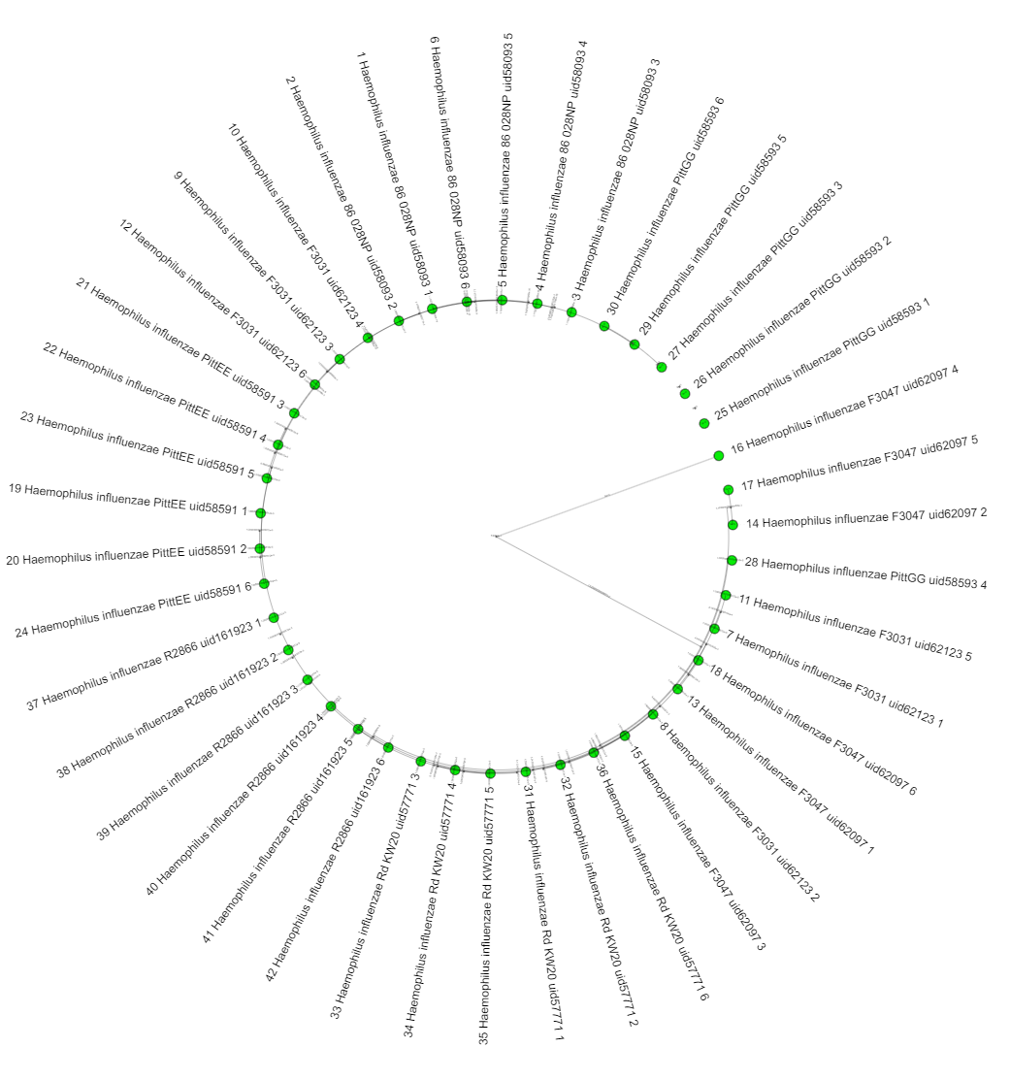
Results
Resulting trees are shown with the circular configurations for the same HInfluenza16S data input file.
ITOL utilized the Cipres tree output files for both FastTree and RaxML as inputs to generate the trees.
Nodes are highlighted in green with branches labeled with numerical distances between each similar species sequence.

Slide 19
Raxml vs fasttree
RAXML
FASTTREE
Pros:
Can start from random tree
Produces better results
Topology more accurate
Cons:
Computationally much more expensive
Pros
Usage of profiles instead of distance matrix requires less storages
Speed is superior while not trading accuracy significantly
Ability to parallelize (OpenMP)
Cons
Less accurate

Slide 20
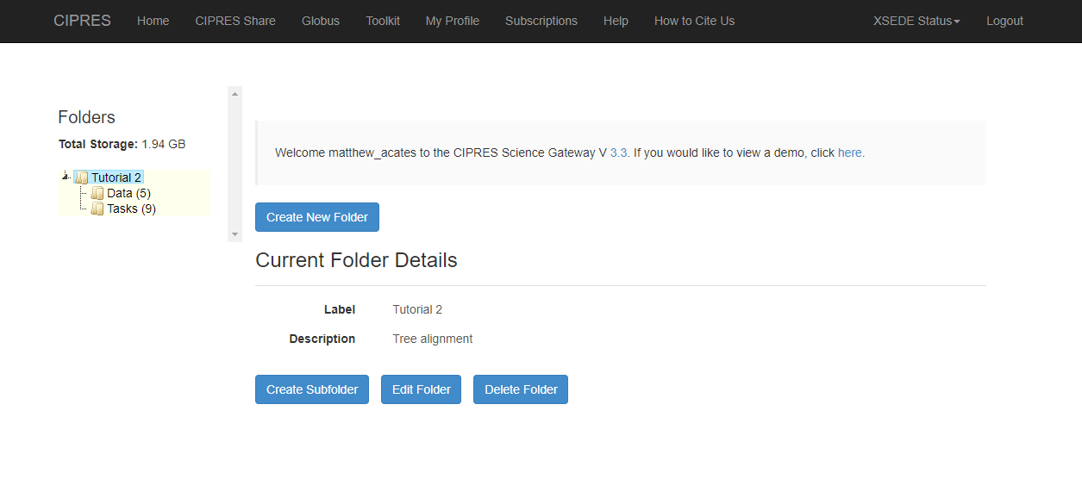
Using cipres

Slide 21
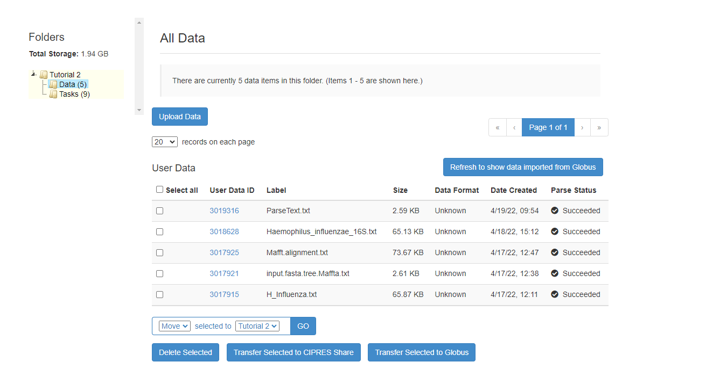
Importing Data

Slide 22
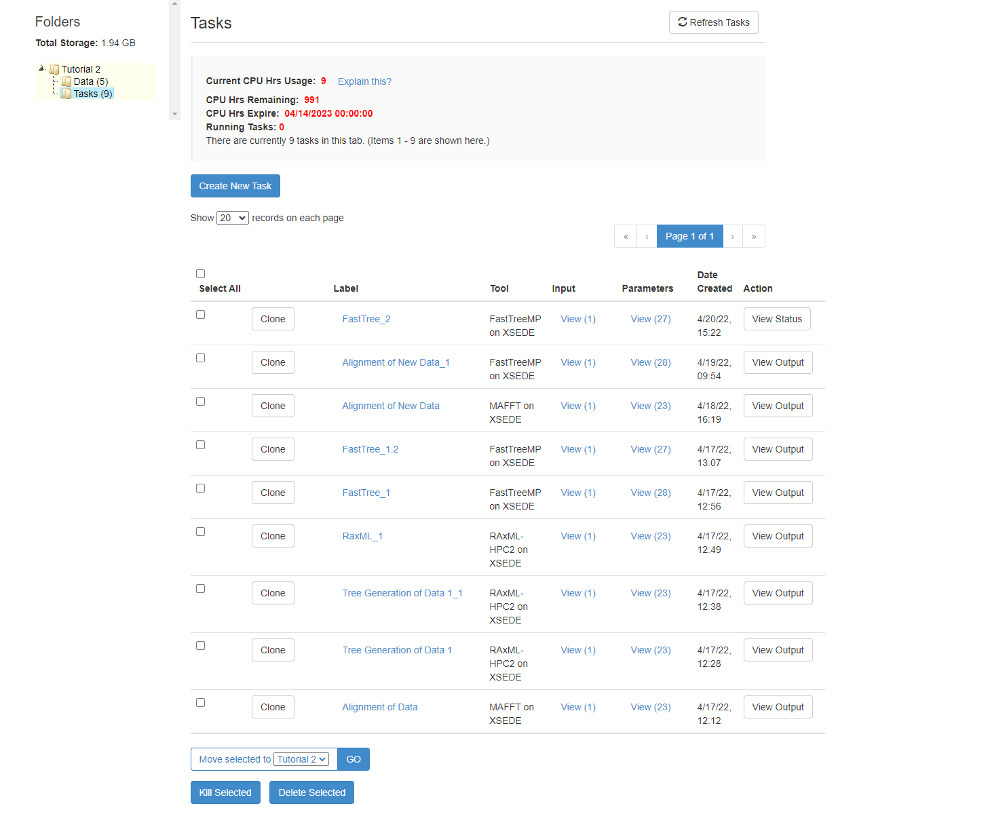
Creating A task

Slide 23
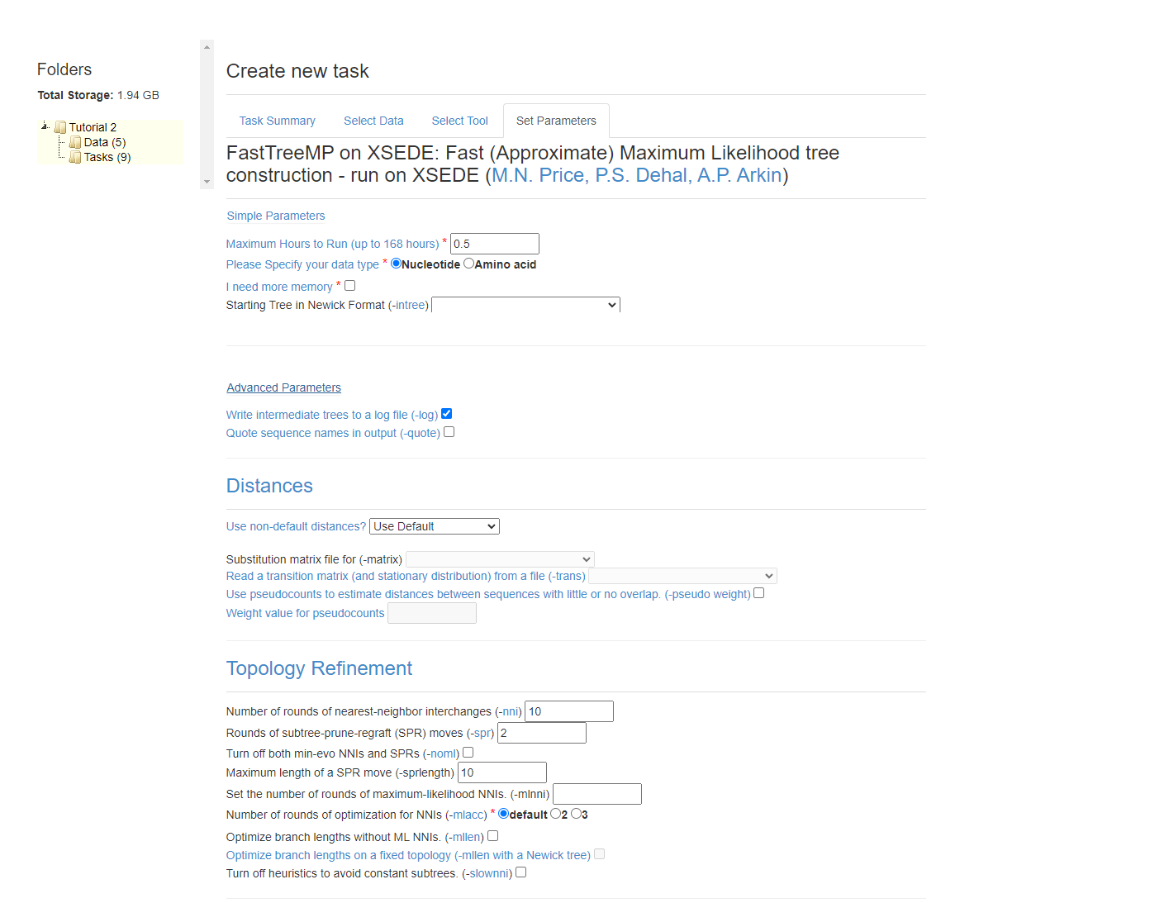
Tool Parameters

Slide 24
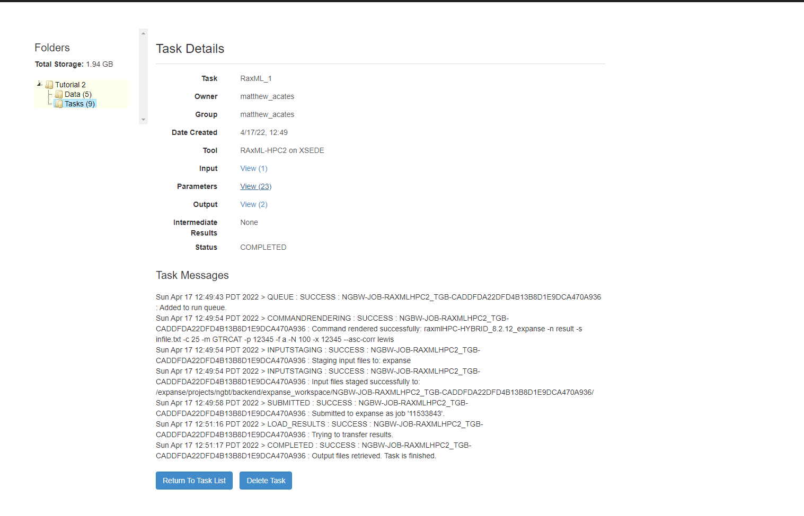
Task Details

